Slide 1


Analog filter design from Flipped koin technology

Slide 2
MESSAGE
FROM FOUNDER
Flipped Koin Technology provides a good learning domain for all enthusiasts of innovation and high tech. It’s a platform that is carefully developed to teach hobbyist from beginner level to a professional level. The approach to all covered aspects are simple and easy to follow. From experience, it is always a good practice to start from examples, and that’s why we have adopted simple explanatory methods to make it easier for our followers. Generally, as a Technology domain, we are much into Electronics, Embedded systems, software development covering the aspect of C,C++, C# and Matlab Programming, and far much into wireless communication and radio frequency technology. Learning is what makes life interesting!! If we can, you can!!! We wish you the best as you get started to learn with us.

Slide 3
FILTERS
iNTRODUCTION
In this tutorial, we will talk about analog filter design, covering the aspect of Low Pass Filter (LPF), High Pass Filter (HPF), Band Pass Filter (BPF), Band Stop Filter (BSF). Analog filters are usually implemented with R,L, and C components or operational amplifiers, and they can be passive or active filters. We will use both Ltspice and Matlab for our simulation. Additionally, we will use c++ language to compute our code for calculating cut-off frequency wherever needed in visual studio.

Slide 4
LOW pass filter

Slide 5
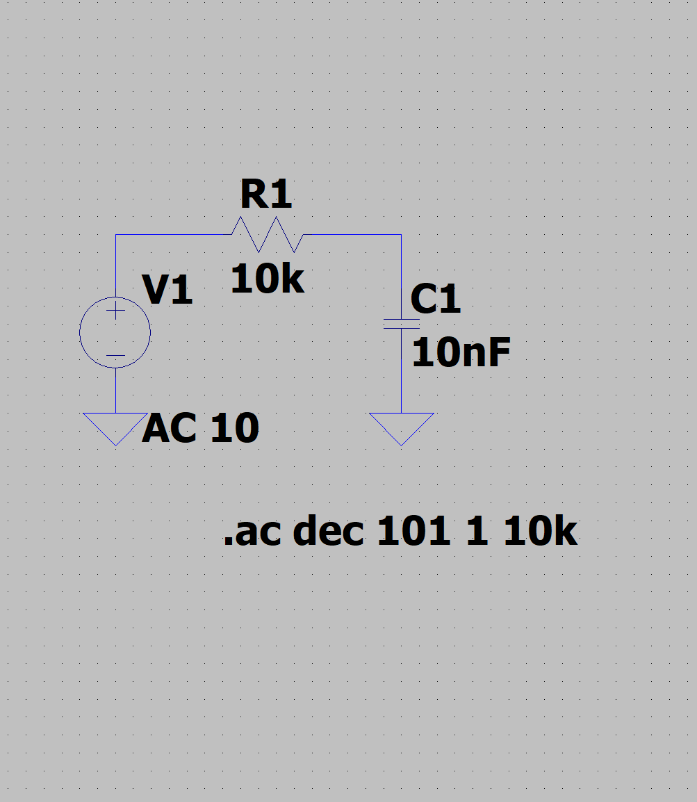
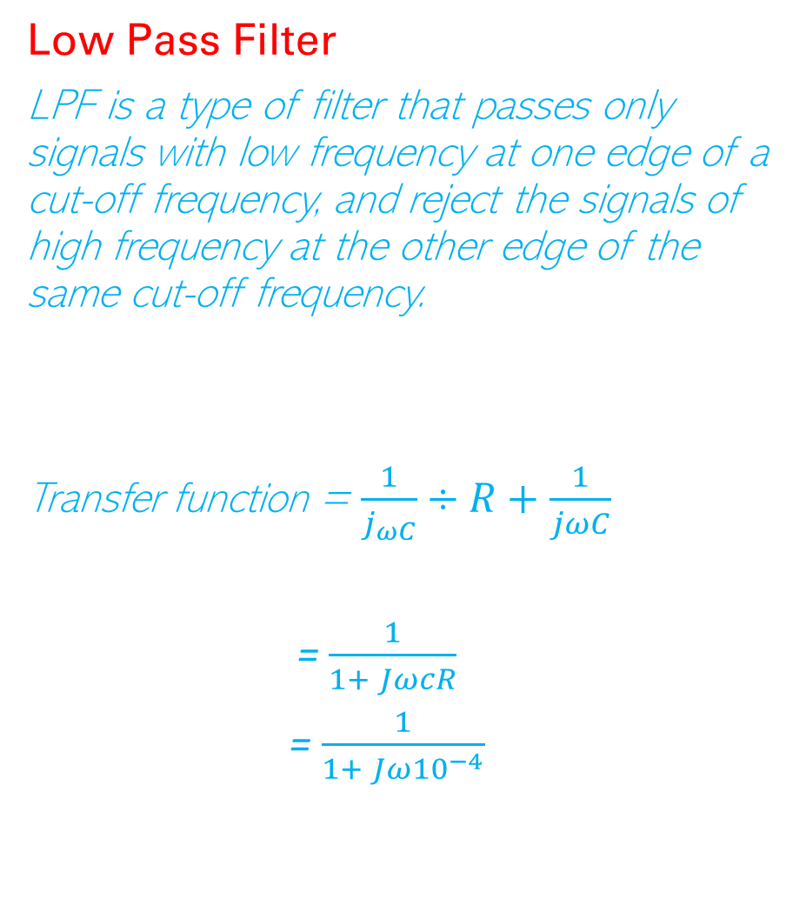
Low Pass Filter
LPF is a type of filter that passes only signals with low frequency at one edge of a cut-off frequency, and reject the signals of high frequency at the other edge of the same cut-off frequency.
Transfer function = $\frac{1}{j_{ωC}}÷R+\frac{1}{jωC}$
= $\frac{1}{1+ JωcR}$
= $\frac{1}{1+ Jω{10}^{−4}}$
Circuit Diagram in LTspice

Slide 6
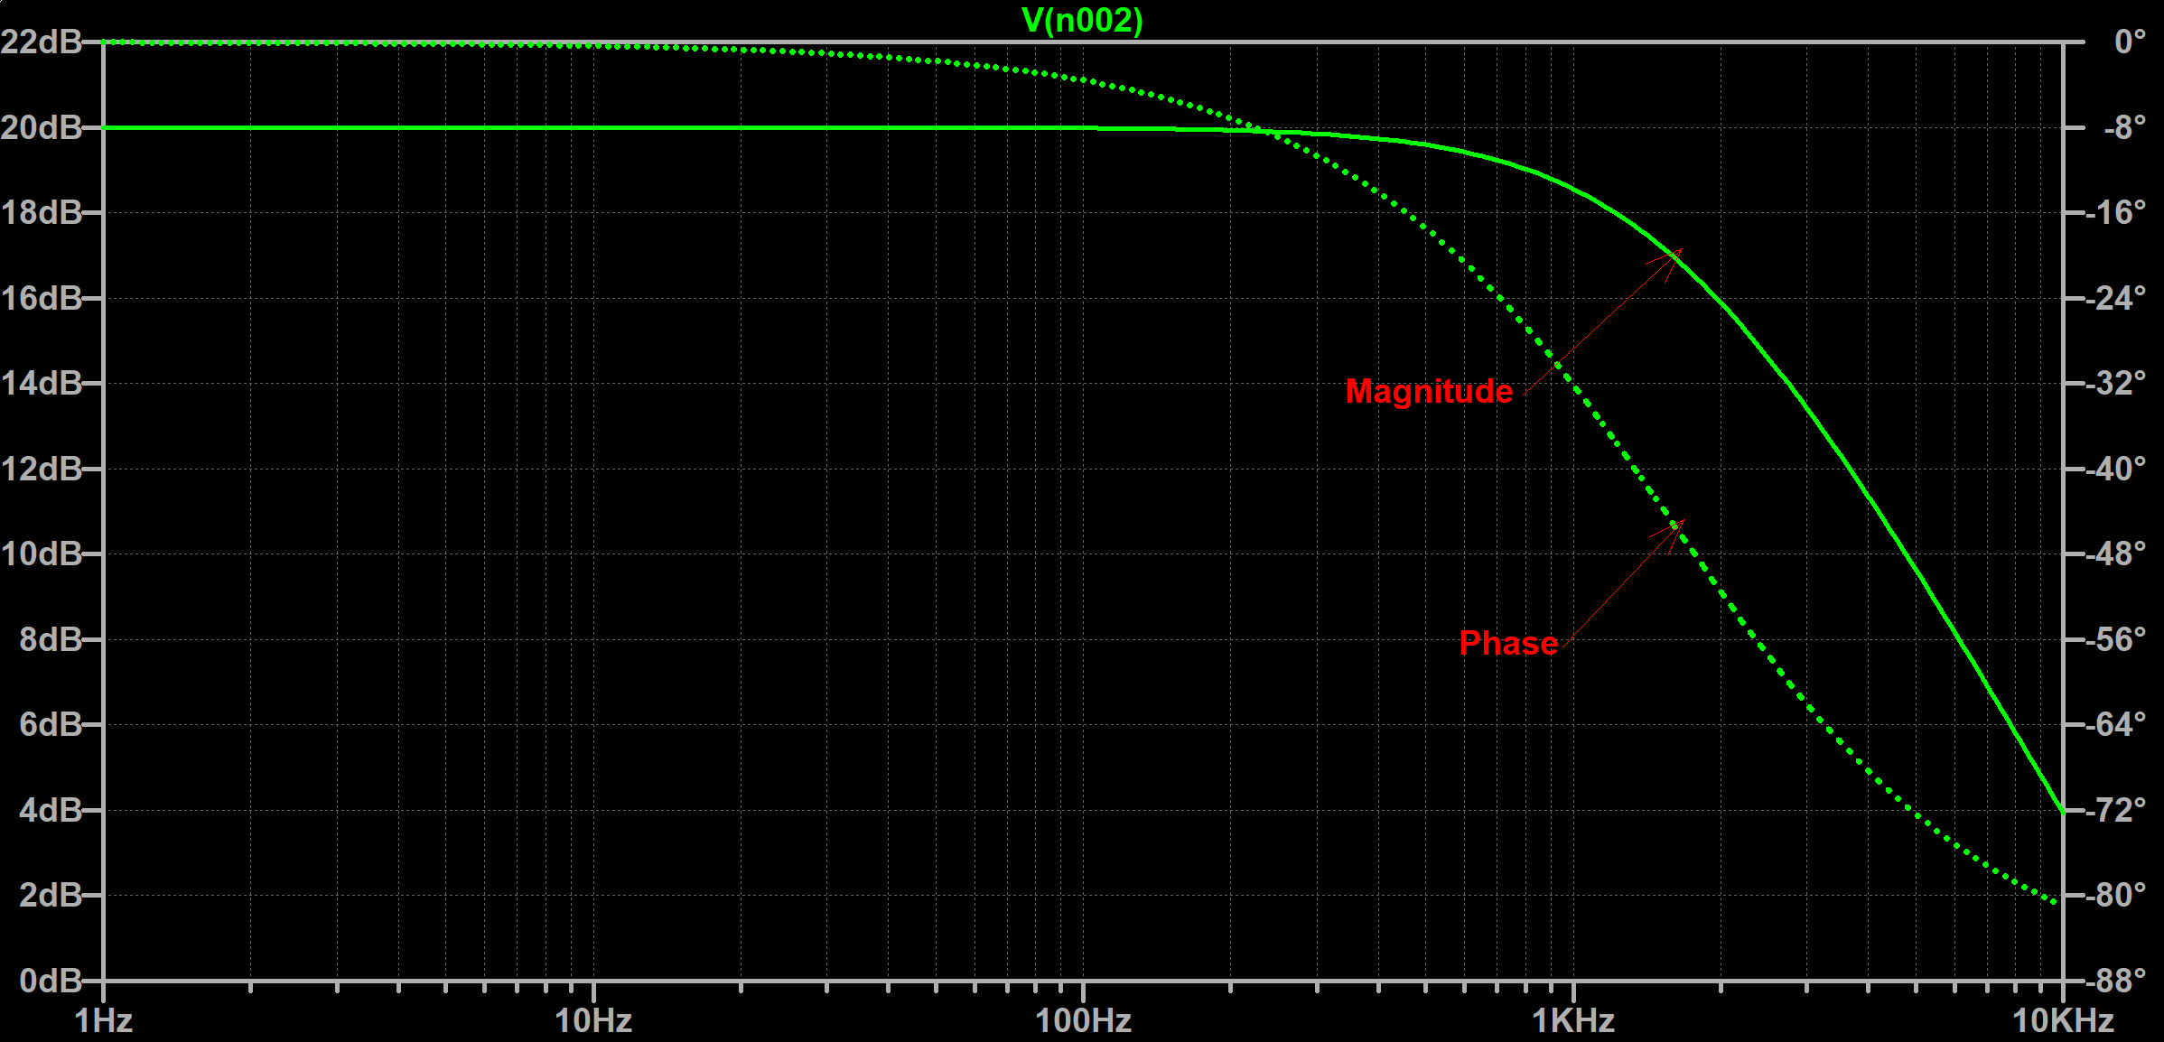
Response (Amplitude and Phase)

Slide 7
Matlab output (Magnitude and Phase)

Slide 8
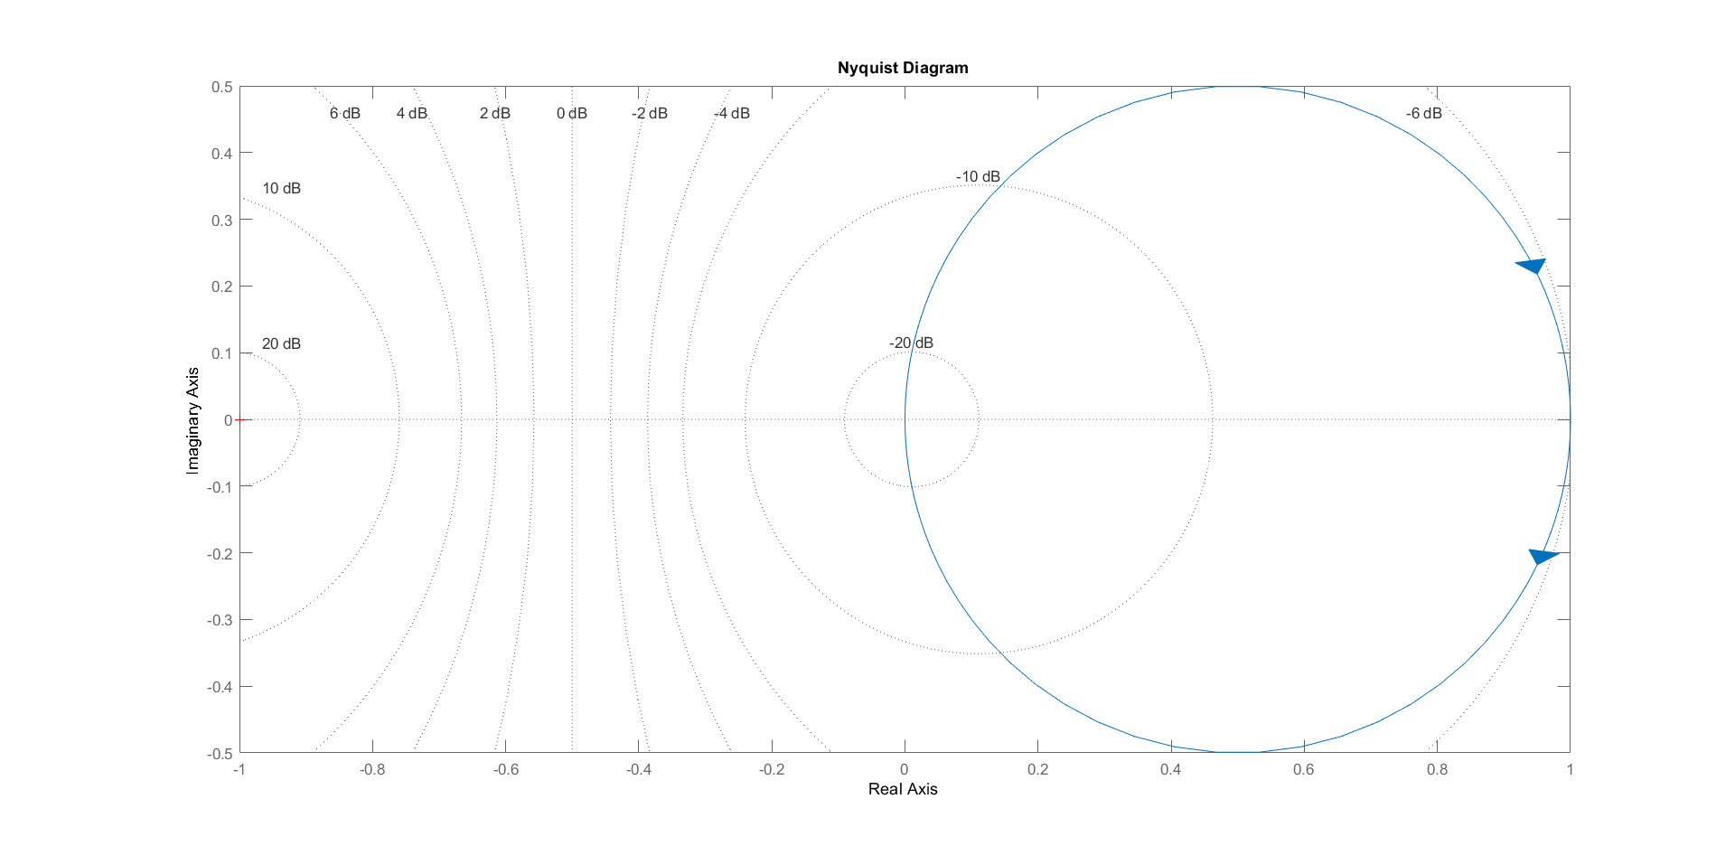
Nyquist Stability plot

Slide 9
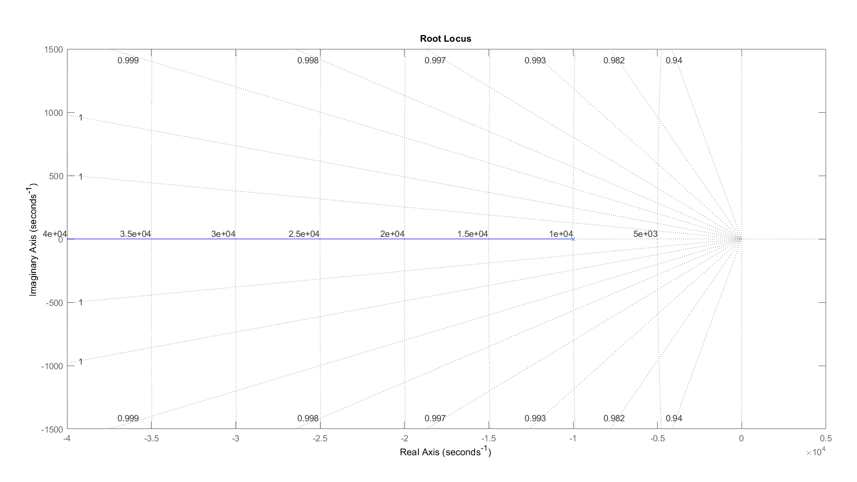
Root Locus Stability

Slide 10
num = [0 1];
den = [0.0001 1];
G = tf (num, den);
G = tf (num, den)
G =
1
------------
0.0001 s + 1
Continuous-time transfer function.
nyquist(G)
grid on
rlocus(G)
grid on
rlocus(G)
Matlab code for the output

Slide 11
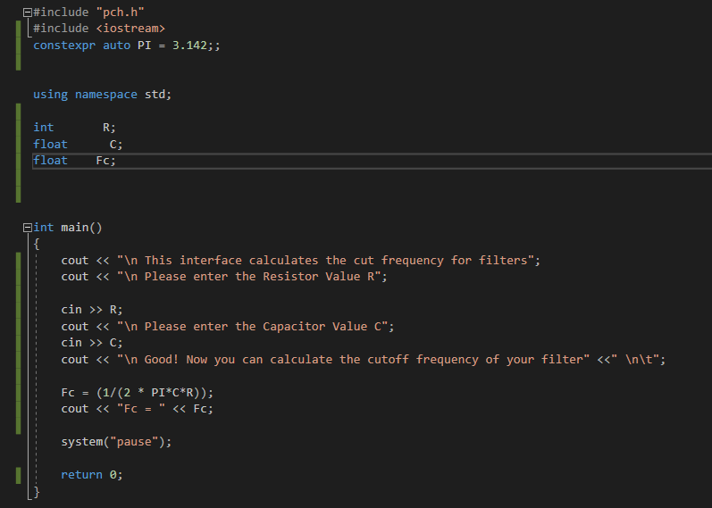
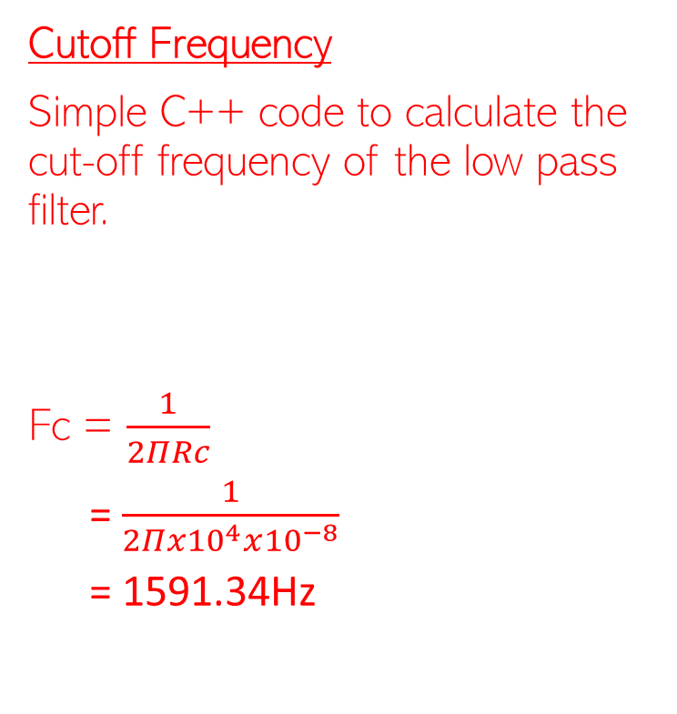
Cutoff Frequency
Simple C++ code to calculate the cut-off frequency of the low pass filter.
Fc = $\frac{1}{2ΠRc}$
= $\frac{1}{2Πx{10}^{4}x{10}^{−8}}$
= 1591.34Hz

Slide 12
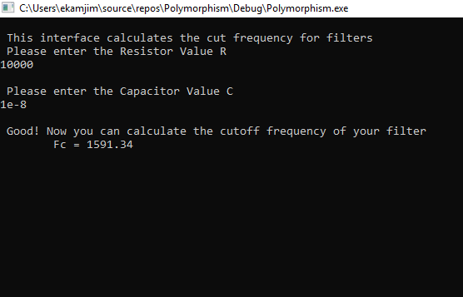
Cutoff Frequency
Fc = 1591.34 Hz is the cut off frequency for the low pass filter.
This is the result of the written code in visual studio to calculate the cutoff frequency.

Slide 13
High pass filter

Slide 14
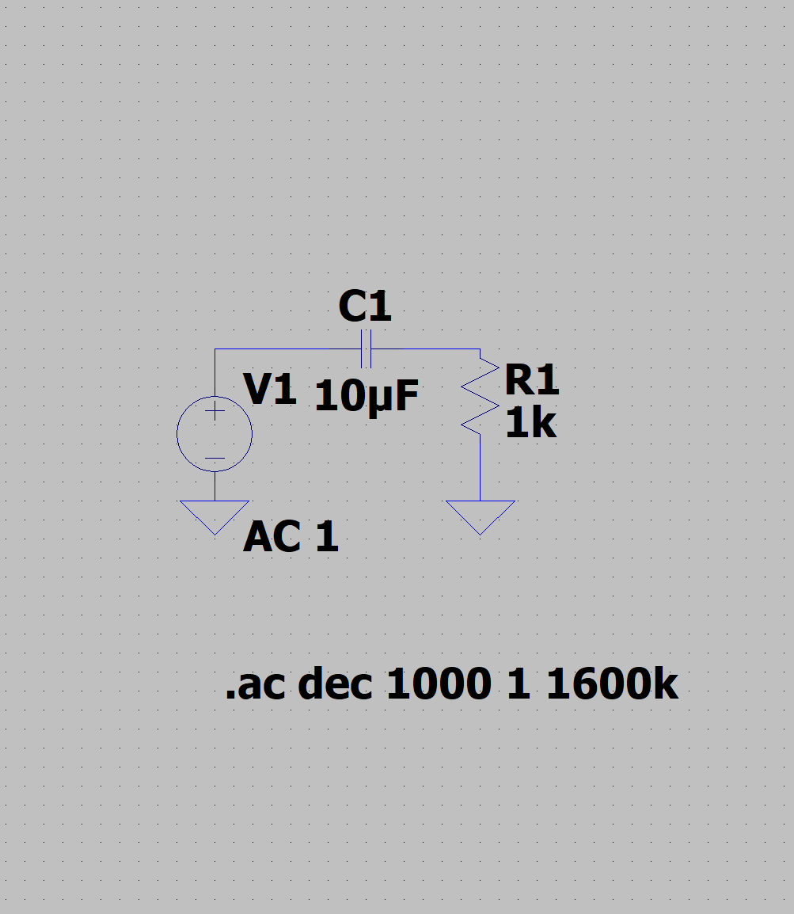
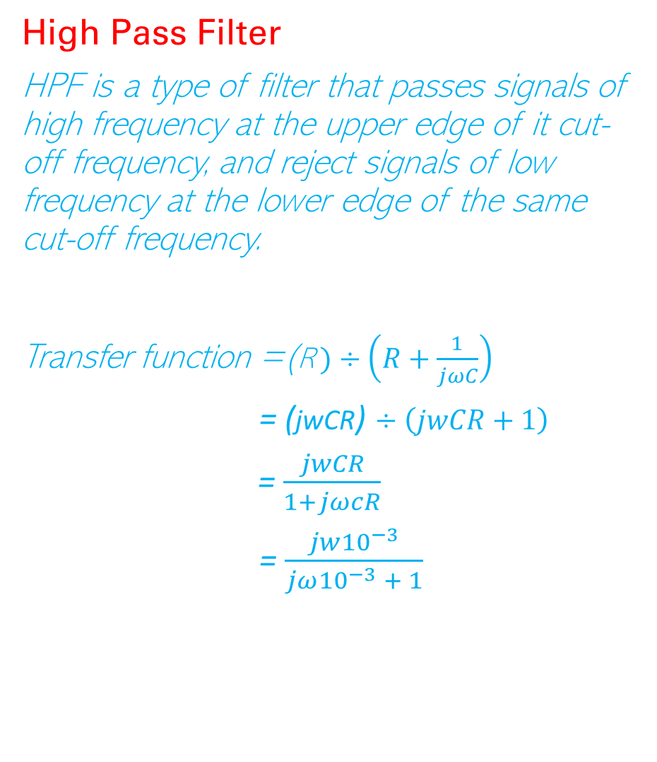
High Pass Filter
HPF is a type of filter that passes signals of high frequency at the upper edge of it cut-off frequency, and reject signals of low frequency at the lower edge of the same cut-off frequency.
Transfer function =(R$)÷\left(R+\frac{1}{jωC}\right)$
= (jwCR) $÷\left(jwCR+1\right)$
= $\frac{jwCR}{1+jωcR}$
= $\frac{jw{10}^{−3}}{jω{10}^{−3} + 1}$
Circuit Diagram in LTspice

Slide 15
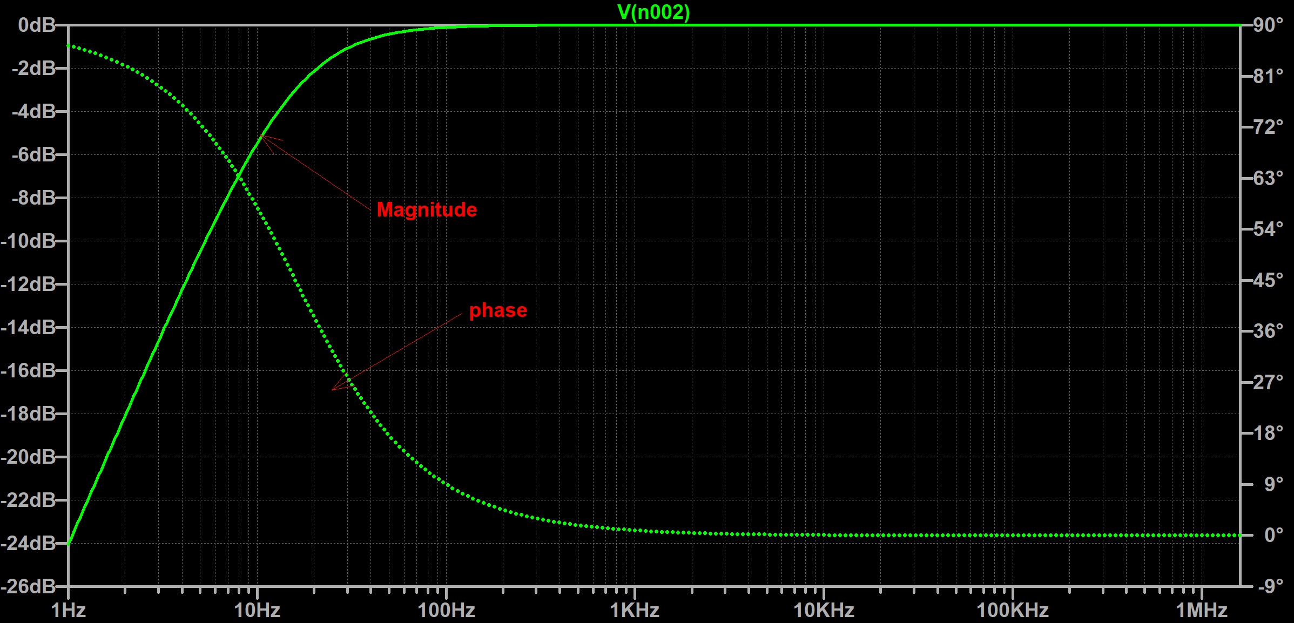
Response (Amplitude and Phase)

Slide 16
Matlab output (Magnitude and Phase)

Slide 17
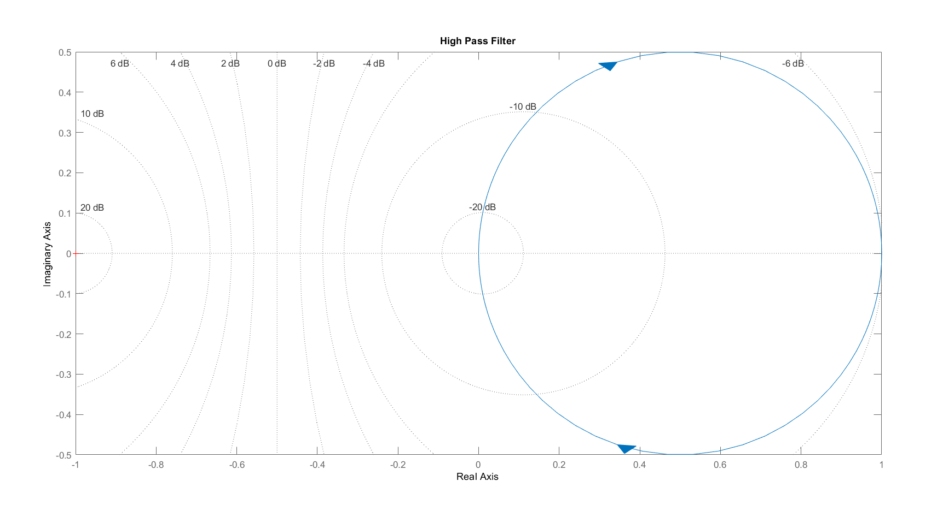
Nyquist Stability Criterion

Slide 18
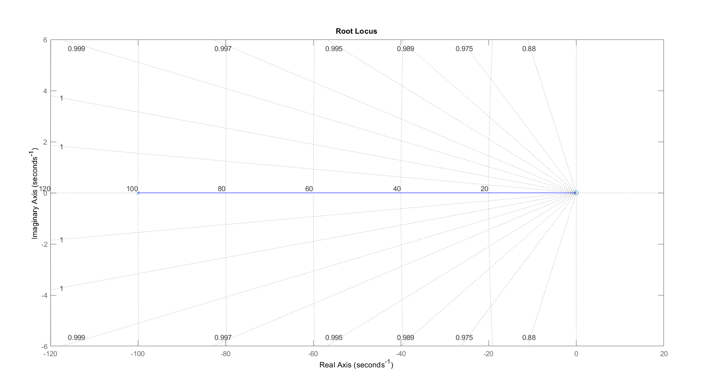
Root Locus Stability

Slide 19
num = [0.01 0];
den = [0.01 1];
H = tf(num, den);
bode(H)
grid on
title('High pass filter')
title('High Pass Filter')
nyquist(H)
grid on
title('High Pass Filter')
rlocus(H)
grid on
Matlab Code for the output

Slide 20
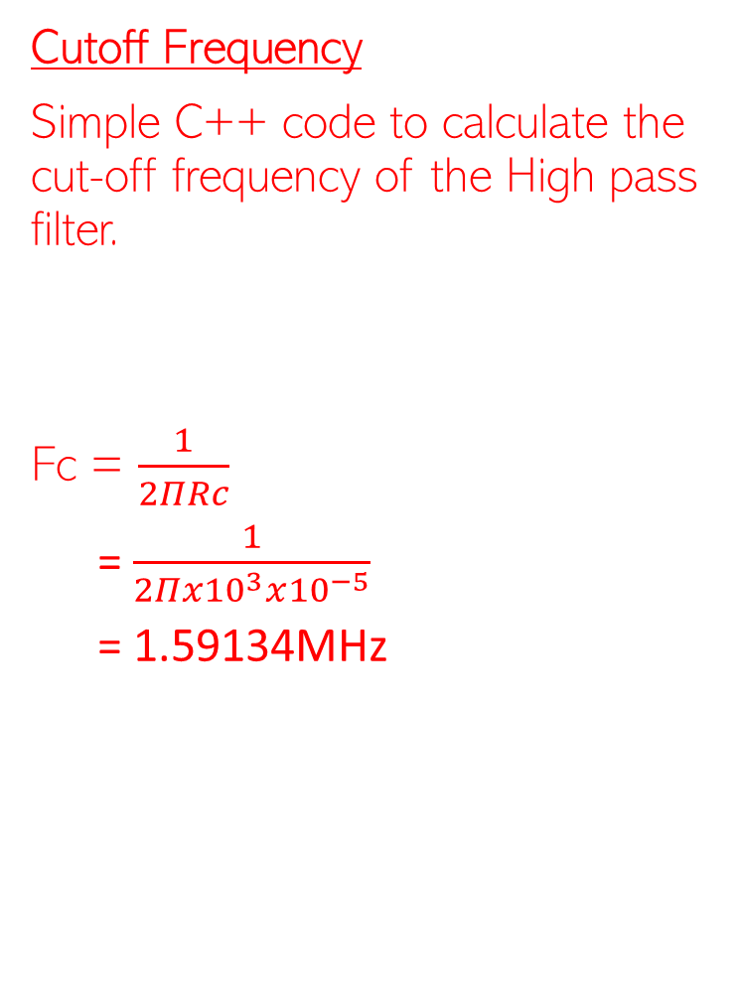
Cutoff Frequency
Simple C++ code to calculate the cut-off frequency of the High pass filter.
Fc = $\frac{1}{2ΠRc}$
= $\frac{1}{2Πx{10}^{3}x{10}^{−5}}$
= 1.59134MHz

Slide 21
End of part one

